Slide 1

Taming the facility data explosion
Damian Flannery
NOBUGS 2008 Sydney
ICAT
The ICAT system explained

Slide 2

Damian Flannery
The Problem(s)
ICAT
Large Data Volumes
High Throughput
Proliferation of data formats
Multiple Data Analysis Step
Increasing complexity of data
Data Access requirements (Sharing and Restriction)
Versioning of data formats and associated software
Distributed Computation (accessed offline from research chain)
Common names and units for temperature, pressure etc.
Changing / differing metadata requirements
International users / federation of data from facilities
Relating to Proposals and Publications
Ontologies
Provenance (Creation, Ownership, History)
Governments want return on investment

Slide 3
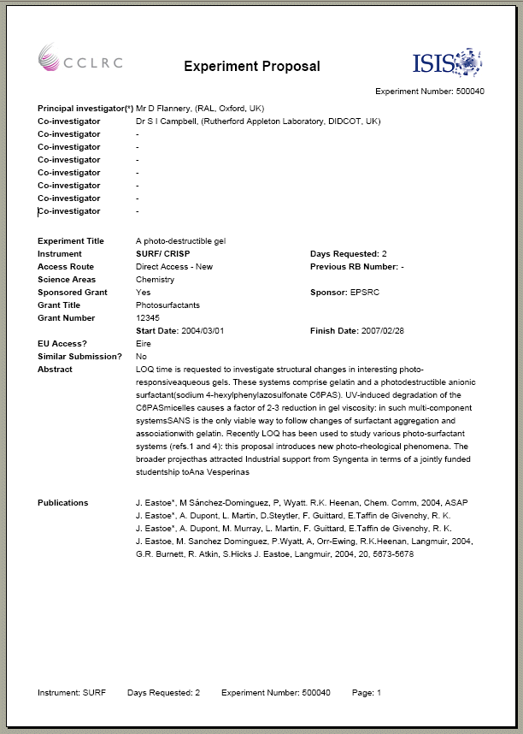
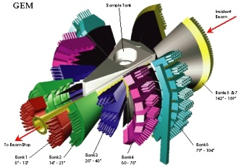
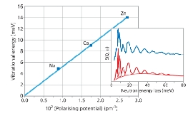




Damian Flannery
What is ICAT?
ICAT
What is ICAT ?
ICAT is a database (with a well defined API) that provides a uniform interface to experimental data and a mechanism to link all aspects of research from proposal through to publication.
Access data anywhere via the web
Annotate your data
Search for data in a meaningful way e.g. taxonomy, Sample, temperature, pressure etc
Share data with colleagues
Access data via your own programs (C++, Fortran, Java etc.) via the ICAT API
Identify potential collaborations
Utilise integrated e-Science High-Performance Computing and Visualisation resources
Link to data from your publications
Etc.
Example ISIS Proposal
GEM – High intensity, high resolution neutron diffractometer
H2-(zeolite) vibrational
frequencies vs polarising
potential of cations
B-lactoglobulin protein
interfacial structure
Proposals
Once awarded beamtime at ISIS, an entry will be created in ICAT that describes your proposed experiment.
Experiment
Data collected from your experiment will be indexed by ICAT (with additional experimental conditions) and made available to your experimental team
Analysed Data
You will have the capability to upload any desired analysed data and associate it with your experiments.
Publication
Using ICAT you will also be able to associate publications to your experiment and even reference data from your publications.

Slide 4
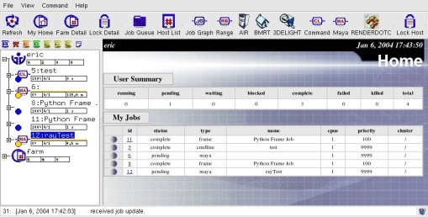
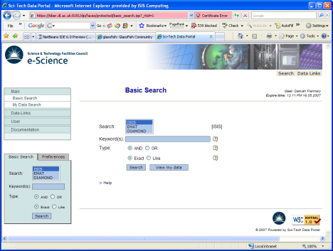
Damian Flannery
Overview
ICAT
User Database System
Single Sign On
Data Storage/ Delivery System
Proposal System
Publication System
ICAT API
e-Science Services
RDBMS
Software Repository
Web Services API
Command Line Tools
Fortran
C++
Java
Glassfish / JBOSS

Slide 5
Damian Flannery
Federation
ICAT
User Database System
Single Sign On
Data Storage/ Delivery System
Proposal System
ISIS
SNS
ANSTO
Publication System
User Database System
Single Sign On
Data Storage/ Delivery System
Proposal System
User Database System
Single Sign On
Data Storage/ Delivery System
Proposal System
ICAT API
Publication System
Publication System
ICAT API
ICAT API
e-Science Services
e-Science Services
e-Science Services
RDBMS
RDBMS
RDBMS
Software Repository
Software Repository
Software Repository
Web Services API
Web Services API
Web Services API
Data Portal

Slide 6
Damian Flannery
Data Model
ICAT
Name
Parent Id
Topic Level
Topic
Publication
Keyword
Full Reference
URL
Repository
Name
User Id
Role e.g Admin, Deleter, Updater, Reader, Creater, Downloader etc.
Element Type
Element Id
Authorisation
Investigation
Reference / Proposal Id
Previous Reference
Facility
Instrument
Title
Abstract
Etc.
Investigator
User Id
Role
Name
Sample Id
Description
Dataset
Sample
Sample Parameter
Name
Units
String Value
Numeric Value
Range Top
Range Bottom
Error
Name
Chemical Formula
Safety Information
Datafile
Dataset Parameter
Name
Units
String Value
Numeric Value
Range Top
Range Bottom
Error
Name/Units/Value etc
Searchable
Is Sample Parameter
Is Dataset Parameter
Is Datafile Parameter
Verified
Name
Description
Version
Location
Format
Format Version
Create Time
Modify Time
Size
Checksum
Parameter
Source Datafile Id
Destination Datafile Id
Relation
S/W Apllication
S/W Version
Related Datafile
Datafile Parameter
Name
Units
String Value
Numeric Value
Range Top
Range Bottom
Error

Slide 7

Damian Flannery
ICAT API
ICAT
Service Oriented Architecture
  Services exposed as Web Services
  User required to authenticate in order to obtain Session Token
  Token is used in all subsequent API calls to for authorisation
The API is modular in order to fit the needs of the facilities
  Plugin own user database
  Plugin data delivery system
Chracteristics
  Platform independent [Java]
  Application Server independent [EJB3]
  Database Independent (Almost!) [JPL]
  Language independent [Web Services]
Internals
  Core functionality implemented as POJOs using JPA
  For deployment EJB3 Session Beans bind the core API, user db and data delivery aspects together
  Services are unit tested using JUNIT
  Services are logged at every interaction point using LOG4J

Slide 8
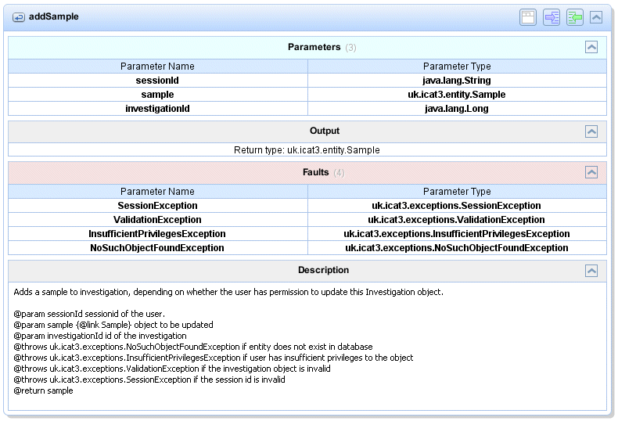
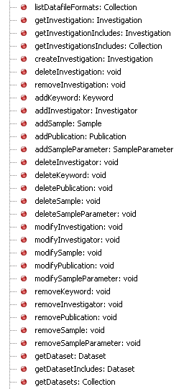
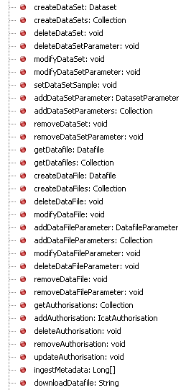
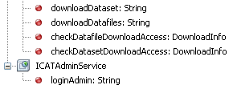
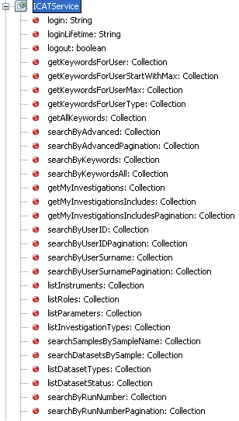
Damian Flannery
ICAT API Continued
ICAT

Slide 9
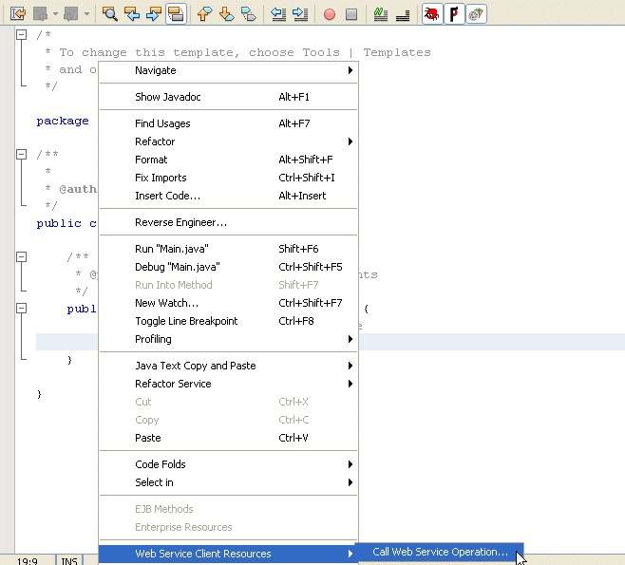
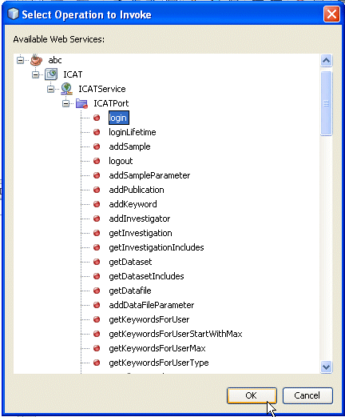
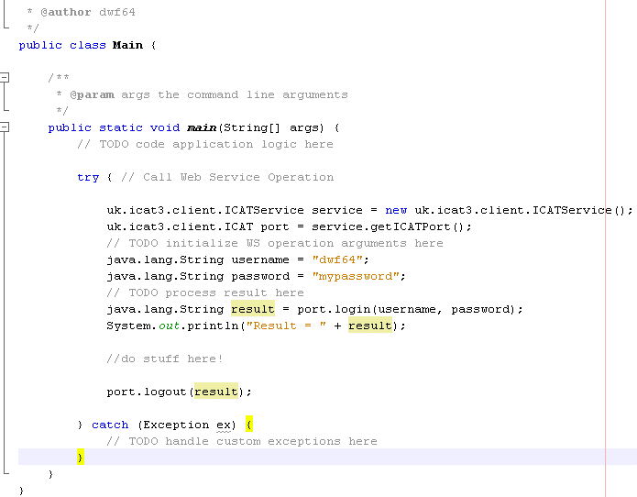
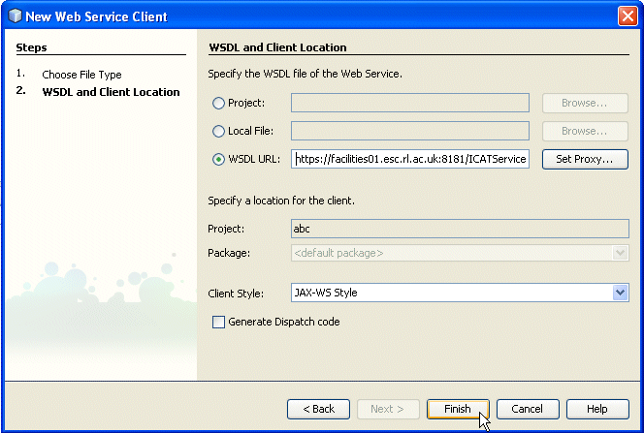
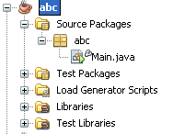
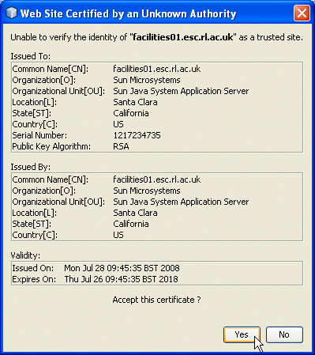
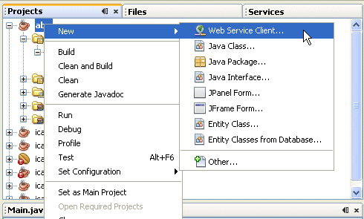
Damian Flannery
ICAT Client
ICAT

Slide 10
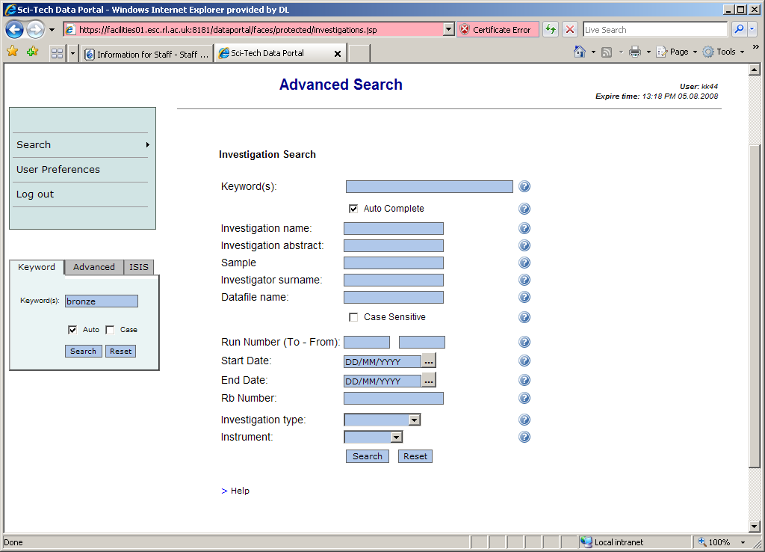
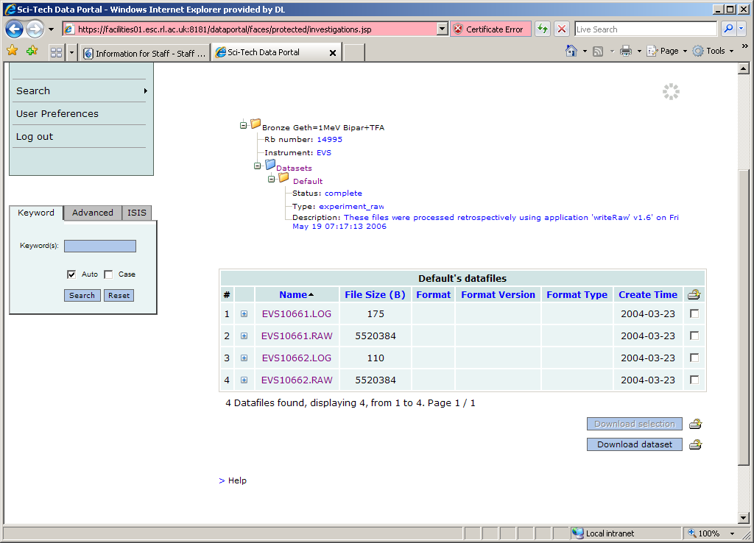
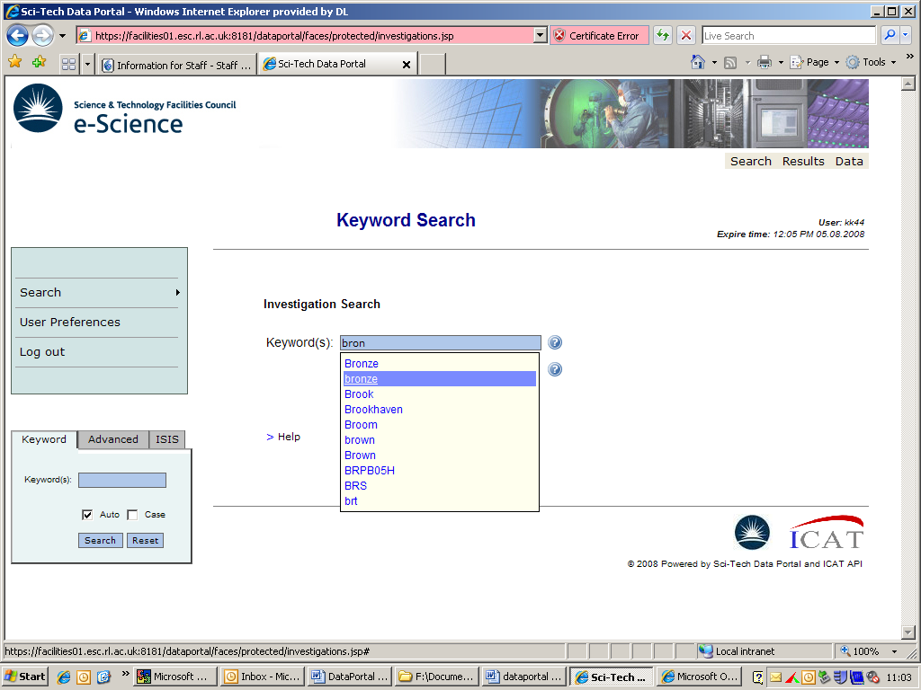
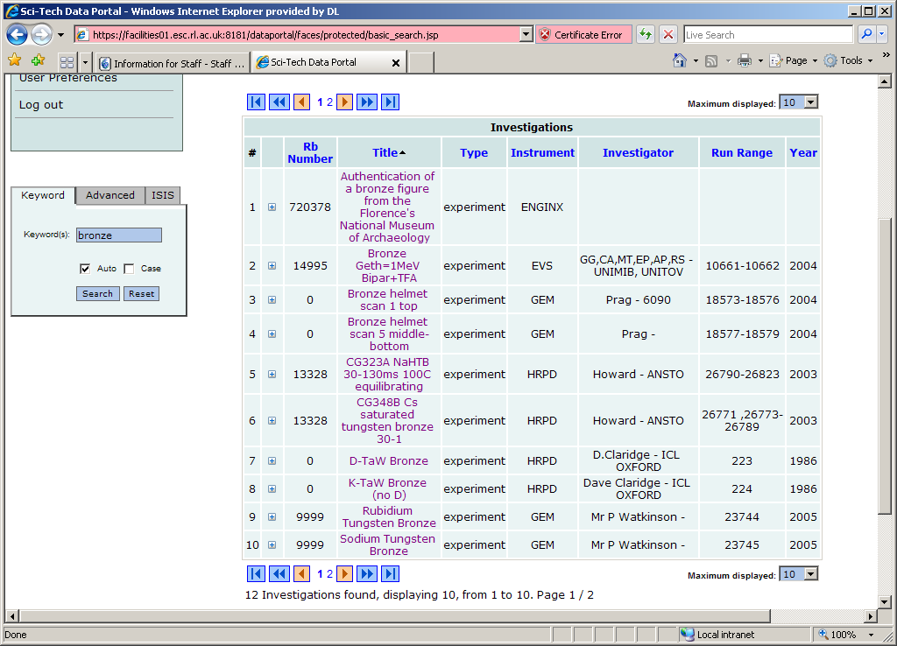
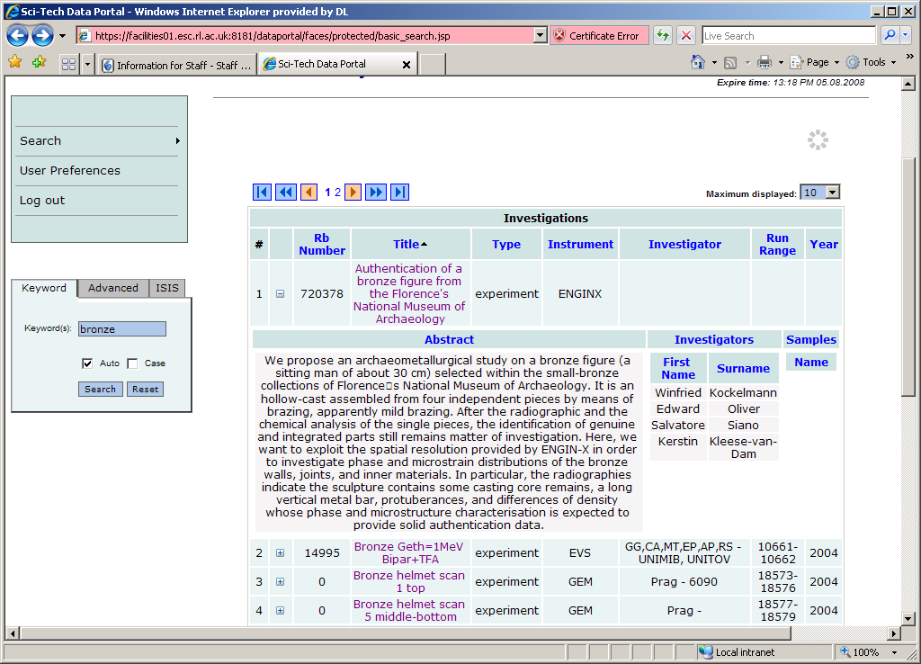
Damian Flannery
Data Portal
ICAT

Slide 11

Damian Flannery
Security
ICAT
Role based permissions
  [Super]
  Admin
  Create
  Delete
  Update
  Download
  Read
Data Policy
  3 year embargo on data (+1 if requested)
  Commercial data is never made public
  Instrument Scientists can access all data from their beamline
  Calibration data is public
  Any data that involves IPR (e.g. analysed) is private for perpetuity unless explicitly shared by user
SSL

Slide 12
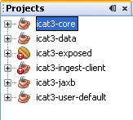
Damian Flannery
Installation / Development
ICAT
Installation
Any O/S
Oracle 10G/11G
Java 6 Update 6
Apache Ant v1.7+
Glassfish v2 UR2
Installed & Configured Cog Kit
Unzip download bundle
Update properties files e.g. database details
Run Ant commands
Technologies Used
  Java
  NetBeans 6.1
  Glassfish UR2
  Ant
  JUnit
  JMeter
  Log4J
  EJB3
  JPA
  JAX-WS
  JAXB
  Oracle (10G / 11G)
  Subversion
Development

Slide 13
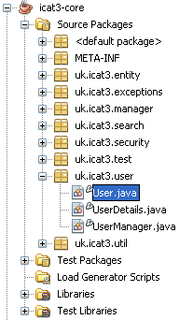
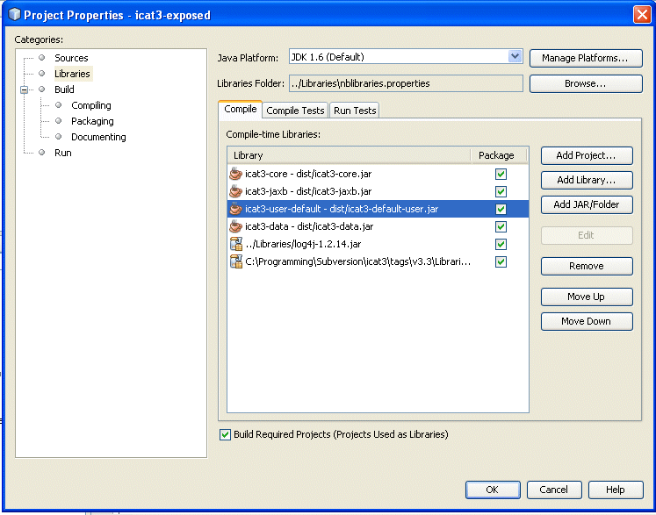
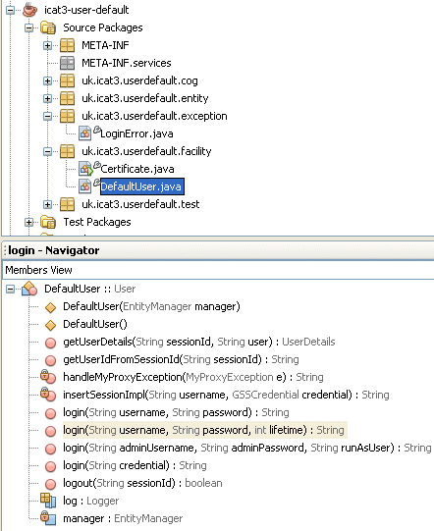
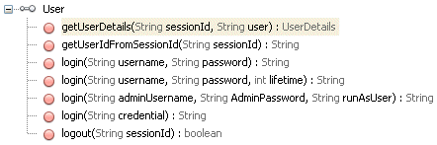
Damian Flannery
User Database
ICAT

Slide 14

Damian Flannery
Data Delivery
ICAT
1
User performs search via application e.g. Data Portal
2
Search is executed in ICAT
3
Permitted results are returned to application
7
Data.ISIS
4
Results are displayed to the user
10
5
User performs request to download datafile, multiple datafiles or dataset
5
1
8
6
ICAT creates http GET link and passes to back to user (routed through application)
sessionId
email (optional)
fileId(s) or datasetId
action (i.e. download, zip, compressed)
4
Data Portal
7
User clicks http link
2
8
Data.ISIS call ICAT API to check permissions
sessionId & datafileId(s) or datasetId
9
3
6
9
Return Exception on failure or
DownloadObject on success
- userId
- array [filename, cycle, run number]
ICAT API
10
User gets their data!

Slide 15
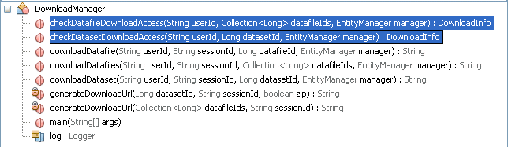
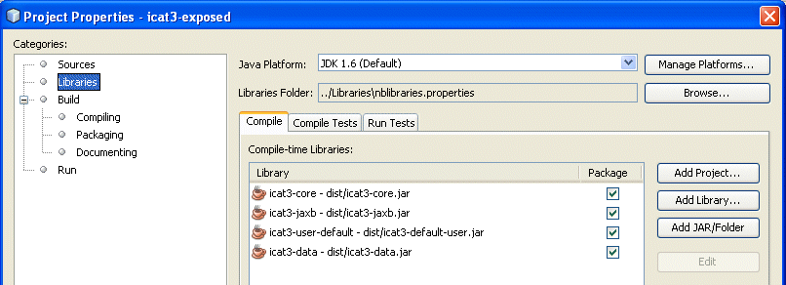
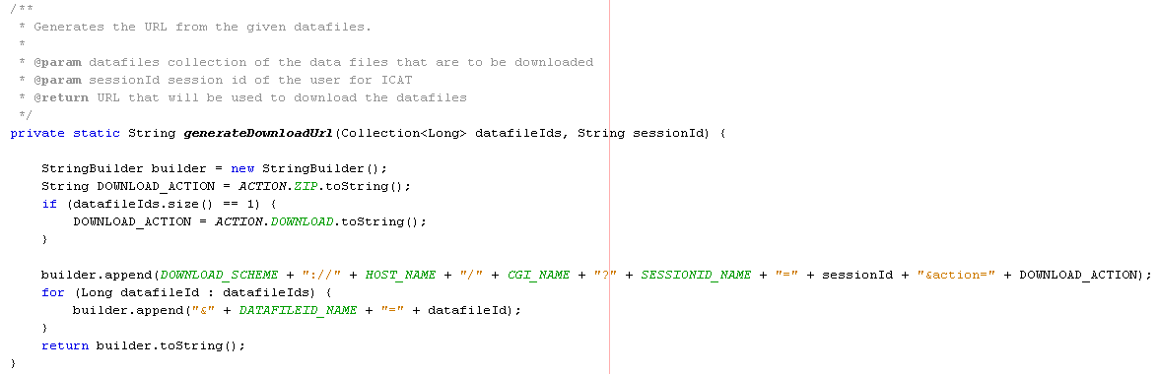
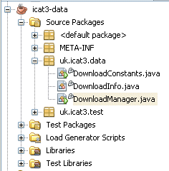
Damian Flannery
Data Delivery Continued
ICAT

Slide 16
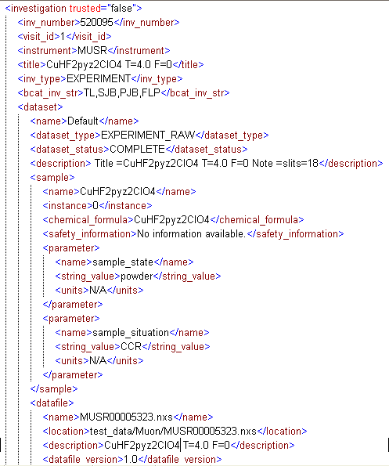
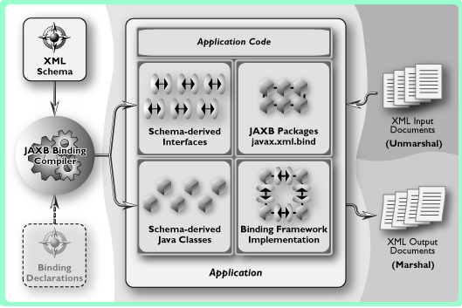
Damian Flannery
XML Ingest
ICAT
User Database System
Single Sign On
Data Storage/ Delivery System
Proposal System
Validation
Publication System
XSD
ICAT API
e-Science Services
RDBMS
Software Repository
InvestigationId
Web Services API
XMLIngest(xml)
Client

Slide 17
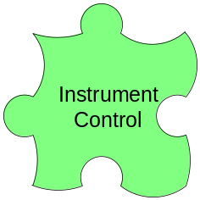
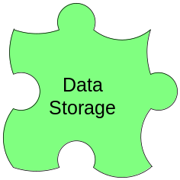
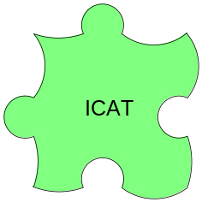
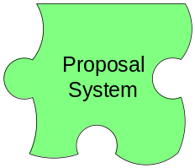

Damian Flannery
ISIS Integration
ICAT
Trigger
NXIngest
RawIngest

Slide 18
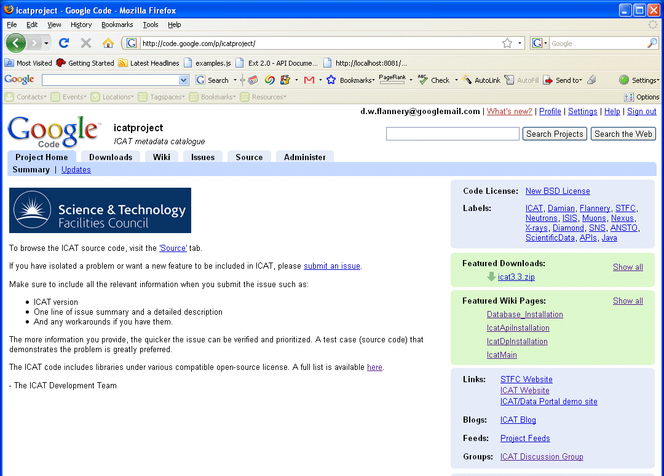
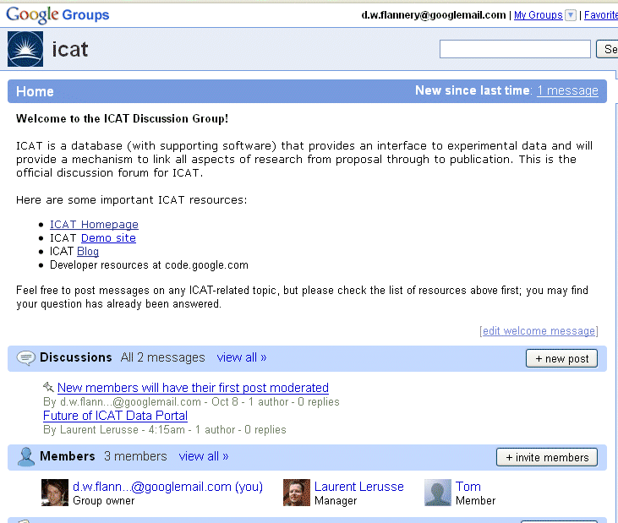

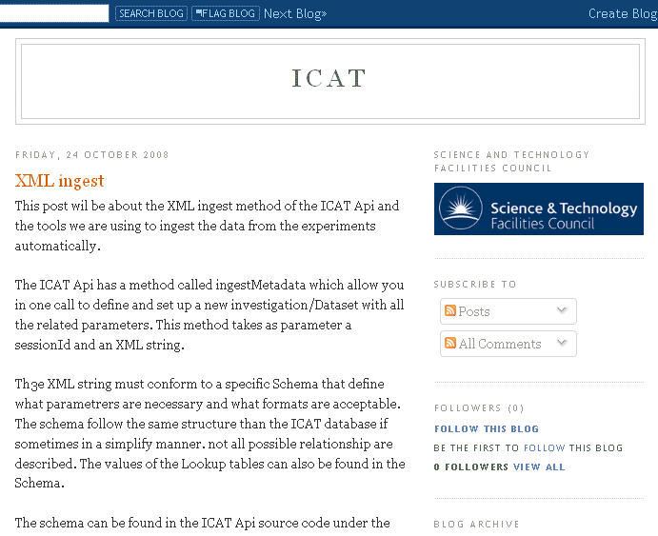
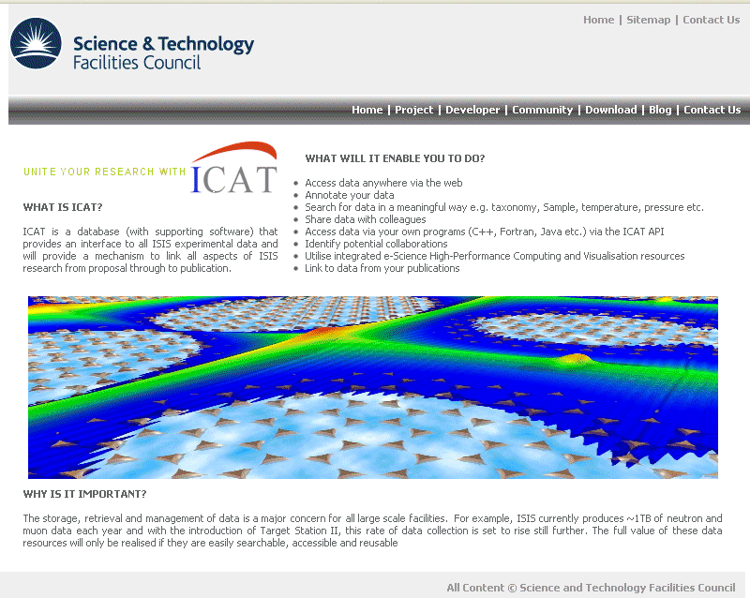
Damian Flannery
Developers
ICAT

Slide 19

Damian Flannery
Future Developments
ICAT
Release Data Portal to ISIS users
Move XML Ingest into asynchonous Message Driven Bean
Rule-based policy implementation
Expand and improve the supplied interface
Proposal System integration
Publication System integration
Database independent
Consequence…
Look at issue/tickets & forum!

Slide 20
Damian Flannery
Summary
ICAT
At ISIS
  Volume of data ~4TB
  ~3M datafiles (22 instruments, 330/hour)
  6.7GB metadata, 33M rows
  550+ unit & stress tests
Attempt to solve problems as outlined earlier in this talk
Software characteristics
  Scalability
  Maintainability
  Reliability
  Availability
  Extensibility
  Performance
  Manageability
  Security
We want to drive this forward
We would like to do it in collaboration with other facilities

Slide 21
Damian Flannery
Acknowledgements
ICAT
ISIS
  Robert McGreevy, Kenneth Shankland, Tom Griffin, Stuart Ansell
  Freddie Akeroyd, Chris Moreton-Smith, Matt Clarke, Kevin Knowles, Steven King, Adrian Hillier, Alex Hannon, Rob Dalgleish
e-Science
  Glen Drinkwater, Shoaib Sufi, Kerstin Kleese Van Dam, Laurent Lerusse, Rik Tyer, Phil Couch
  Gordon Brown, Kier Hawker, Carmine Coiffe
  Roger Downing

Slide 22

Damian Flannery
Questions
ICAT
http://code.google.com/p/icatproject

